Slide 1
C Programming Workshop
KJ’s Trinity College of Engineering & Research, Pune
Rushikesh Tanksale

Slide 2
Session I 11AM-1 PM 28 Sept
Introduction to C
Your First C Code
New Line & Comments
Variables in C
Datatypes in C
Format Specifiers
Constants

Slide 3
Start of Session I

Slide 4
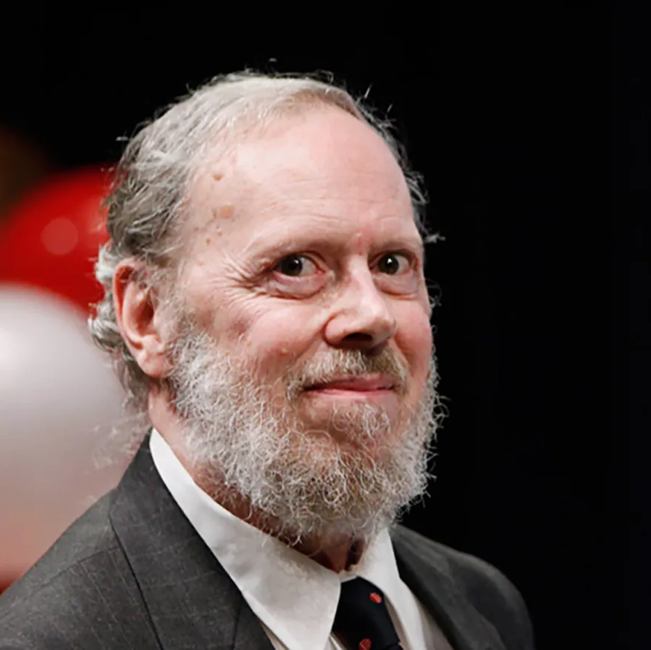

Introduction to C
Developed by Dennis Ritchie at the Bell Laboratories in 1972.
Very Popular Language Despite Being Old
Still used for development
Unreal & Other Game Engine Still need C++ for development
C is strongly associated with UNIX

Slide 5
C Program Code Flow
C program (source code) is sent to preprocessor first. The preprocessor is responsible to convert preprocessor directives into their respective values. The preprocessor generates an expanded source code.
Expanded source code is sent to compiler which compiles the code and converts it into assembly code.
The assembly code is sent to assembler which assembles the code and converts it into object code. Now a simple.obj file is generated.
The object code is sent to linker which links it to the library such as header files. Then it is converted into executable code. A simple.exe file is generated.
The executable code is sent to loader which loads it into memory and then it is executed. After execution, output is sent to console

Slide 6
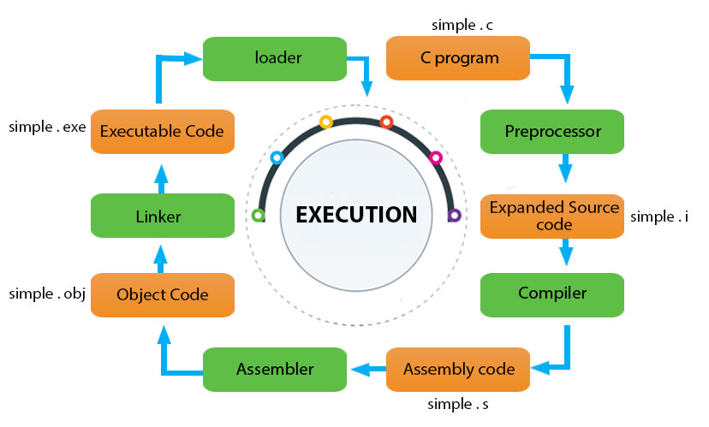
C Program Code Flow

Slide 7
Structure of C Code
Part | Example
Header | #include<stdio.h
Main() | Int main() {
Variable Declaration | Int a=10;
Body | Printf(“%d”,&a);
Return | Return 0; }

Slide 8
Your First C Code
#include <stdio.h> int main() { printf("Hello World!"); return 0; }

Slide 9
Output Statements
So as we can see printf() doesn't add new lines on output console.
So we need to use “\n” in order to get output on next line
Basically the “\n” is called escape sequence.
Apart from “\n” there are other “\t” which adds horizontal tab between output statements.
“\\” will add single backslash while \” will add quotes.

Slide 10
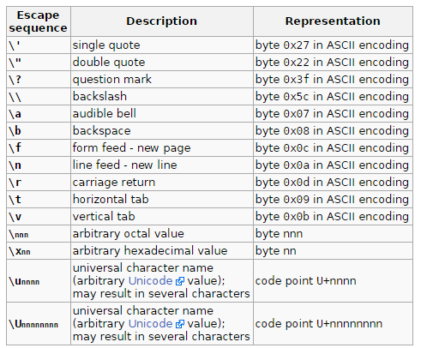
Output continued.

Slide 11
Comments in C
Comments can be used to explain code, and to make it more readable. It can also be used to prevent execution when testing alternative code.
Comments can be singled-lined or multi-lined.
Single Line Comment starts with //.
Multiline comments start with /* and end with */.

Slide 12
Code 2: To Demonstrate Newline & Comments

Slide 13
Variables in C
In C, there are different types of variables (defined with different keywords), for example:
int - stores integers (whole numbers), without decimals, such as 123 or -123
float - stores floating point numbers, with decimals, such as 19.99 or -19.99
char - stores single characters, such as 'a' or 'B'. Char values are surrounded by single quotes

Slide 14
Declaring a Variable
Type variablename = value;
Example
int a =10;
We can even assign value after declaring.
int a;
a=10;
If you assign a new value to an existing variable, it will overwrite the previous value:
Int a=10; //value is 10
a = 15; //value is 15

Slide 15
Data Types in C
The data type specifies the size and type of information the variable will store.
int: Integers are whole numbers that can have both zero, positive and negative values but no decimal values
float & double: are used to store real numbers
The size of float (single precision float data type) is 4 bytes. And the size of double (double precision float data type) is 8 bytes

Slide 16
Data Types in C
char: Keyword char is used for declaring character type variables.
short and long: If you need to use a large number, you can use a type specifier long. Else if it’s a small integer you can use short.
We can check size of variable using sizeof() operator.
signed and unsigned: Signed allows storing of both +ve & -ve numbers while unsigned allows only +ve.

Slide 17
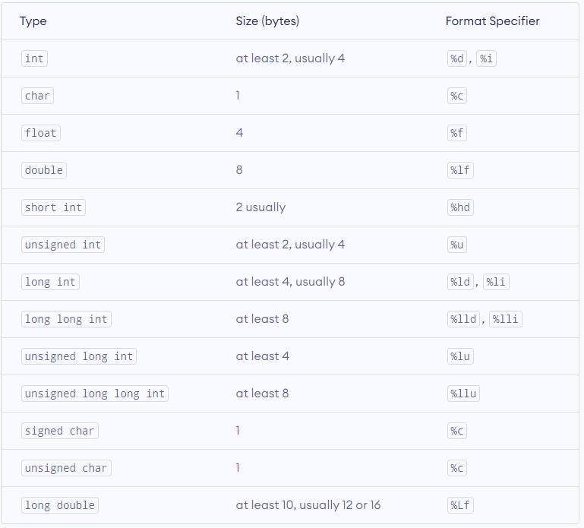
Data Types in C

Slide 18
Printing a variable
In other programming languages you would normally use a print function to display the value of a variable. However, this is not possible in C:
So in order to tackle this issue we need to get familiar to something called format specifiers

Slide 19
Format Specifiers
Format specifiers are used together with the printf() function to tell the compiler what type of data the variable is storing.
It acts like placeholder for variable value
A format specifier starts with a percentage sign % followed by a character

Slide 20
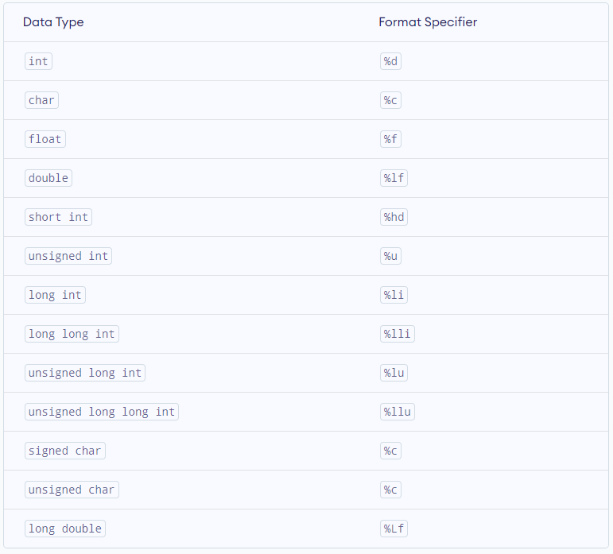
Format Specifiers

Slide 21
Constant in C
When you don't want others (or yourself) to override existing variable values. We use “const” keyword.
When you declare a variable which is constant you must assign value to it.
Another good practice is to write then in UPPER case.

Slide 22
Code 3: To Demonstrate Variable, Data Type & Format Specifiers

Slide 23
End of Session I

Slide 24
Start of Session II

Slide 25
Session II 28 Sept
Operators in C
Looping & Condition Control
Array’s & String
Accepting User Input
Memory Address & Pointers
Predefined Functions
User defined Functions
Types of User Defined Functions
Function Declaration

Slide 26
Operators in C
Operators are used to perform operations on variables and values.
C divides the operators into the following groups:
Arithmetic operators
Assignment operators
Comparison operators
Logical operators
Bitwise operators

Slide 27
Arithmetic Operators
Operator | Name | Description | Example
+ | Addition | Adds together two values | x + y
- | Subtraction | Subtracts one value from another | x - y
* | Multiplication | Multiplies two values | x * y
/ | Division | Divides one value by another | x / y
% | Modulus | Returns the division remainder | x % y
++ | Increment | Increases the value of a variable by 1 | ++x
-- | Decrement | Decreases the value of a variable by 1 | --x
* | Multiplication | Multiplies two values | x * y

Slide 28
Assignment Operators
Operator | Example | Same As
= | x = 5 | x = 5
+= | x += 3 | x = x + 3
-= | x -= 3 | x = x - 3
*= | x *= 3 | x = x * 3
/= | x /= 3 | x = x / 3
%= | x %= 3 | x = x % 3
&= | x &= 3 | x = x & 3
|= | x |= 3 | x = x | 3
^= | x ^= 3 | x = x ^ 3
>>= | x >>= 3 | x = x >> 3
<<= | x <<= 3 | x = x << 3

Slide 29
Comparison Operators
Operator | Name | Example
== | Equal to | x == y
!= | Not equal | x != y
> | Greater than | x > y
< | Less than | x < y
>= | Greater than or equal to | x >= y
<= | Less than or equal to | x <= y

Slide 30
Logical Operators
Operator | Name | Description | Example
&& | Logical and | Returns true if both statements are true | x < 5 && x < 10
|| | Logical or | Returns true if one of the statements is true | x < 5 || x < 4
! | Logical not | Reverse the result, returns false if the result is true | !(x < 5 && x < 10)

Slide 31
Looping & Condition Control
We learned comparison operators from previous slide
C supports the usual logical conditions from mathematics:
Less than: a < b
Less than or equal to: a <= b
Greater than: a > b
Greater than or equal to: a >= b
Equal to a == b
Not Equal to: a != b

Slide 32
Looping & Condition Control
You can use these conditions to perform different actions for different decisions.
C has the following conditional statements:
Use if to specify a block of code to be executed, if a specified condition is true
Use else to specify a block of code to be executed, if the same condition is false
Use else if to specify a new condition to test, if the first condition is false
Use switch to specify many alternative blocks of code to be executed

Slide 33
If, Else and Else If
Use the if statement to specify a block of C code to be executed if a condition is true.
Use the else statement to specify a block of code to be executed if the condition is false.
Use the else if statement to specify a new condition if the first condition is false

Slide 34
Code 4: If-Else If- Else Demo

Slide 35
C Switch Case
Instead of writing many if..else statements, you can use the switch statement.
The switch statement selects one of many code blocks to be executed:

Slide 36
Break & Default Keyword
The break Keyword
When C reaches a break keyword, it breaks out of the switch block.
This will stop the execution of more code and case testing inside the block.
The default Keyword
The default keyword specifies some code to run if there is no case match:

Slide 37
Code 5: C Switch Case Demo

Slide 38
Loops
Loops can execute a block of code as long as a specified condition is reached.
Loops are handy because they save time, reduce errors, and they make code more readable.

Slide 39
While Loop
The while loop loops through a block of code as long as a specified condition is true:

Slide 40
The Do/While Loop
The do/while loop is a variant of the while loop. This loop will execute the code block once, before checking if the condition is true, then it will repeat the loop as long as the condition is true.

Slide 41
Code 6: While Loop Demo Code 7: Do While Loop

Slide 42
The For Loop
When you know exactly how many times you want to loop through a block of code, use the for loop instead of a while loop

Slide 43
Code 8: For Loop Demo

Slide 44
Break Keyword
The break statement can also be used to jump out of a loop.

Slide 45
Continue Keyword
The continue statement breaks one iteration (in the loop), if a specified condition occurs, and continues with the next iteration in the loop.

Slide 46
Array
Arrays are used to store multiple values in a single variable, instead of declaring separate variables for each value.
To create an array, define the data type (like int) and specify the name of the array followed by square brackets [].
To insert values to it, use a comma-separated list, inside curly braces:

Slide 47
String
Strings are used for storing text/characters.
For example, "Hello World" is a string of characters.
Unlike many other programming languages, C does not have a String type to easily create string variables. However, you can use the char type and create an array of characters to make a string in C:

Slide 48
C User Input
You have already learned that printf() is used to output values in C.
To get user input, you can use the scanf() function:

Slide 49
Code 9: Array, String and User Input Demo.

Slide 50
C Functions
A function is a block of code that performs a specific task.
Suppose, you need to create a program to create a circle and color it. You can create two functions to solve this problem:
create a circle function
create a color function
Dividing a complex problem into smaller chunks makes our program easy to understand and reuse.

Slide 51
Predefined or Standard Library Functions
Standard library functions
The standard library functions are built-in functions in C programming.
These functions are defined in header files. For example,
The printf() is a standard library function to send formatted output to the screen (display output on the screen). This function is defined in the stdio.h header file. Hence, to use the printf()function, we need to include the stdio.h header file using #include <stdio.h>.
The sqrt() function calculates the square root of a number. The function is defined in the math.h header file.

Slide 52
User Defined Functions
You can also create functions as per your need. Such functions created by the user are known as user-defined functions.
The execution of a C program begins from the main() function.
When the compiler encounters functionName();, control of the program jumps to function and the execution starts.
The control of the program jumps back to the main() function once code inside the function definition is executed.

Slide 53
Advantages of User Defined Function
Advantages of user-defined function
The program will be easier to understand, maintain and debug.
Reusable codes that can be used in other programs
A large program can be divided into smaller modules. Hence, a large project can be divided among many programmers.

Slide 54
Code 10: User Defined Function

Slide 55
Types of User Defined Function
No Argument Passed and No Return Value
No Arguments Passed But Returns a Value
Argument Passed But No Return Value
Argument Passed and Returns a Value

Slide 56
No Argument Passed and No Return Value
Void userfunction()
{
}

Slide 57
No Argument Passed But Returns a Value
Void userfunction()
{
return 0;
}

Slide 58
Argument Passed But No Return Value
Void userfunction(datatype variable name)
{
}

Slide 59
Argument Passed And a Returns Value
Void userfunction(datatype variable name)
{
Return variablename;
}

Slide 60
Code 11: Types of User Defined Function

Slide 61
Any Questions?
So, Its Wrapped for the Day

Slide 62
Session 3 11AM-1PM
Recursion
Mathematical Functions
Structures in C
Union in C
Introduction to C++
Comparison between C & C++

Slide 63
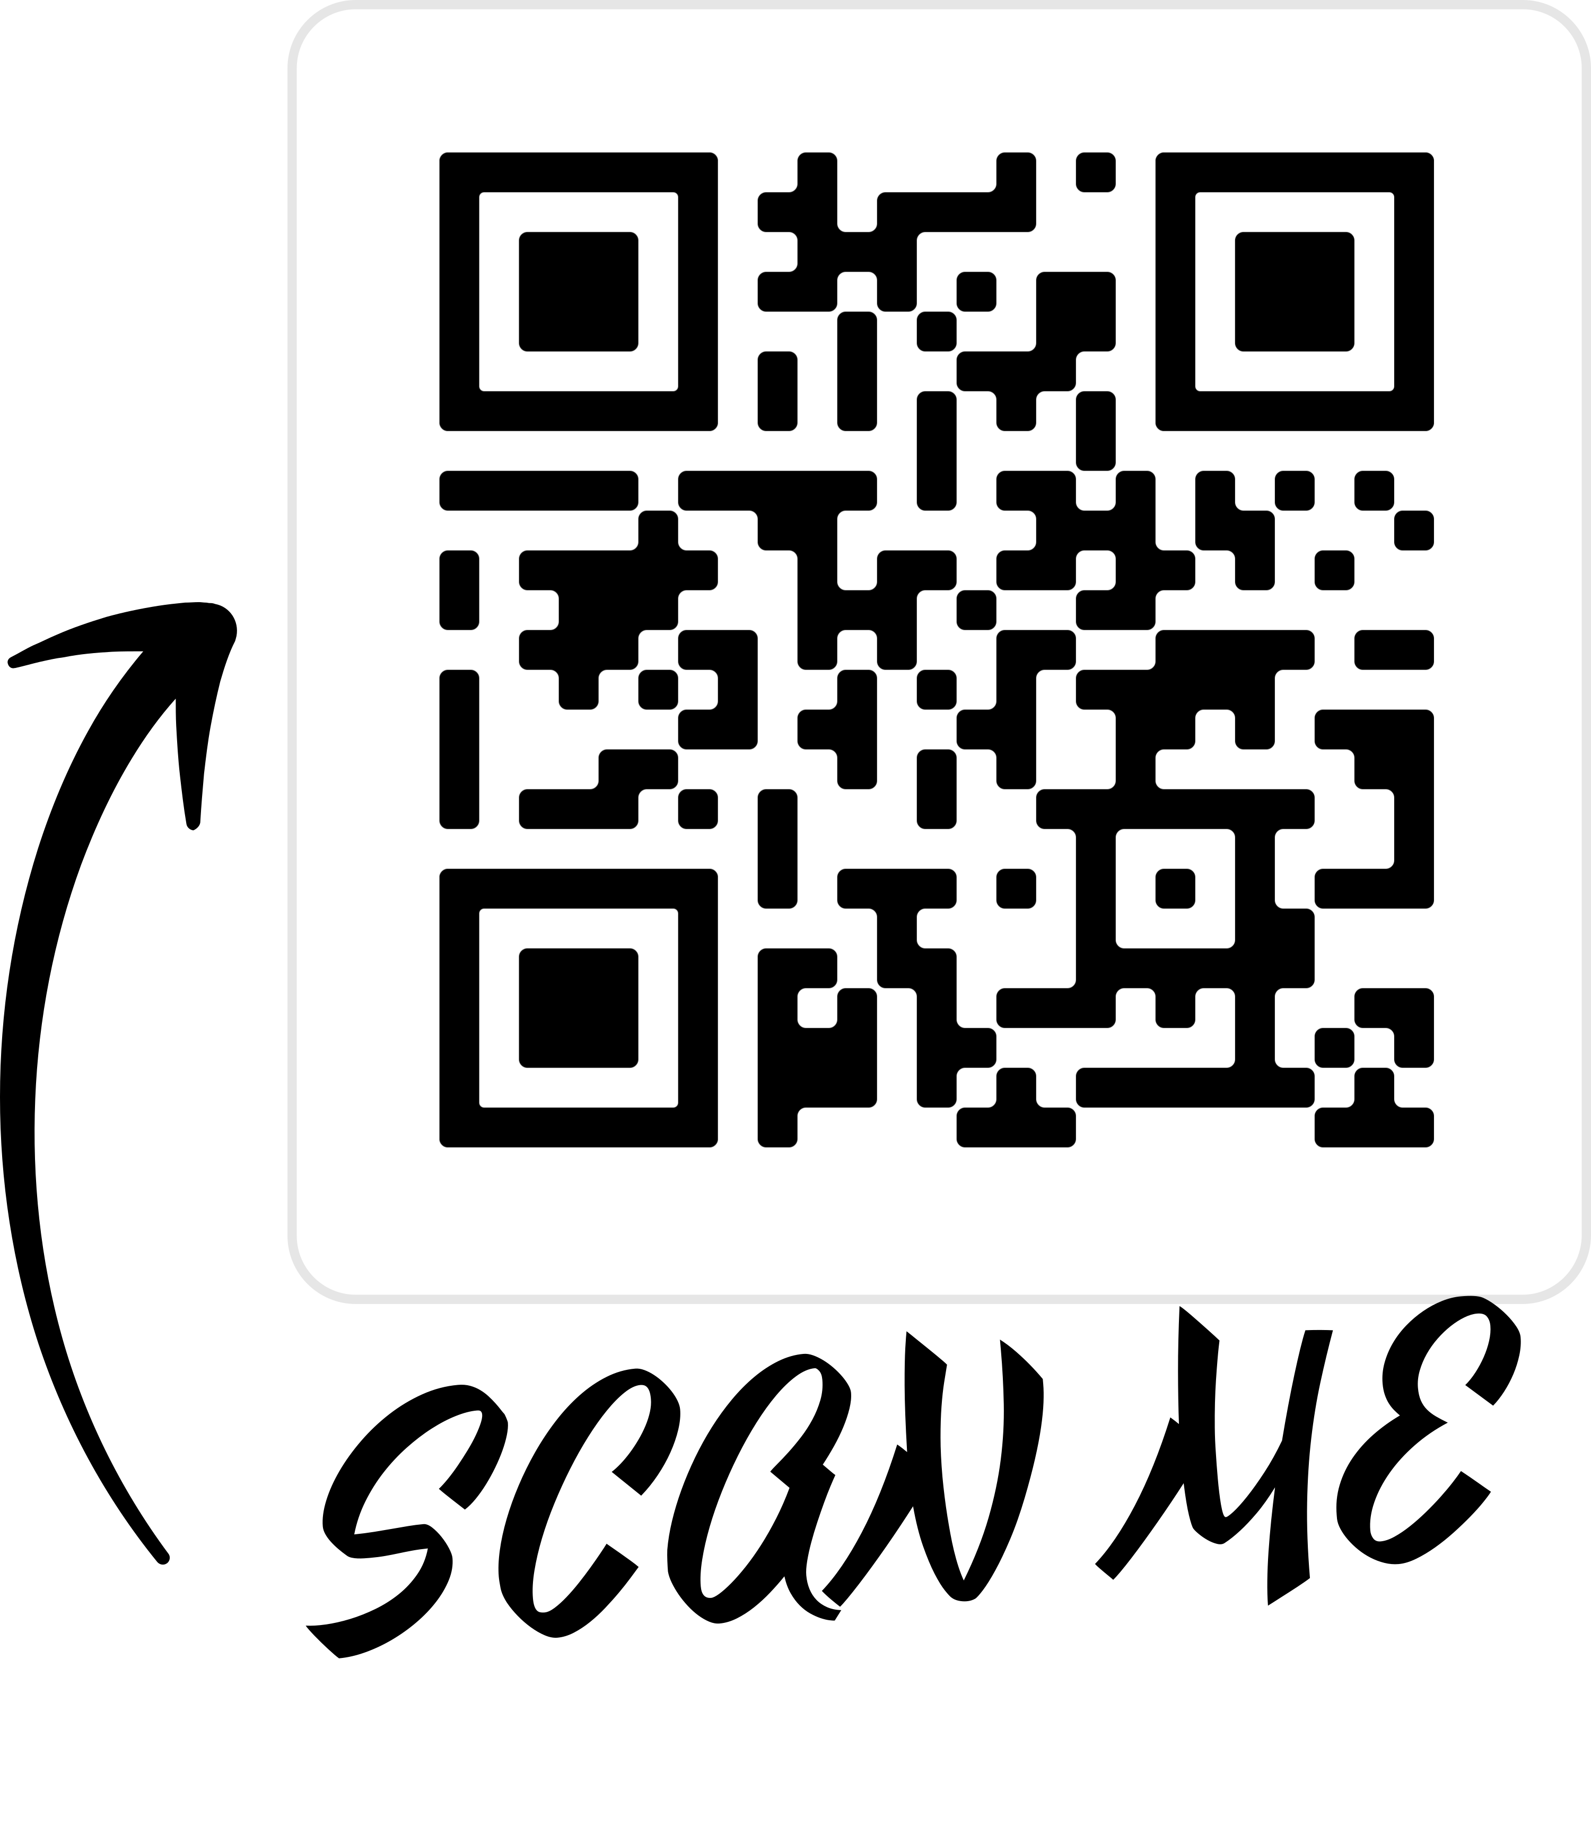
Thank you
Scan the below QR for my social media handles

